Slide 1
Machine Learning Lecture #8 Outline 9/17/2020
Today’s Topic:
1) k-means Clustering

Slide 2
Basic Example of a Cell Array
CELL ARRAY
MyCell{1} = ‘Hello’;
MyCell(2) = {‘World!’};
MyCell{3} = 5;
MyCell(4) = {[1 2 3 4; 5 6 7 8]};
% Get data from cell array
MyCell{4}(2,3) %7

Slide 3
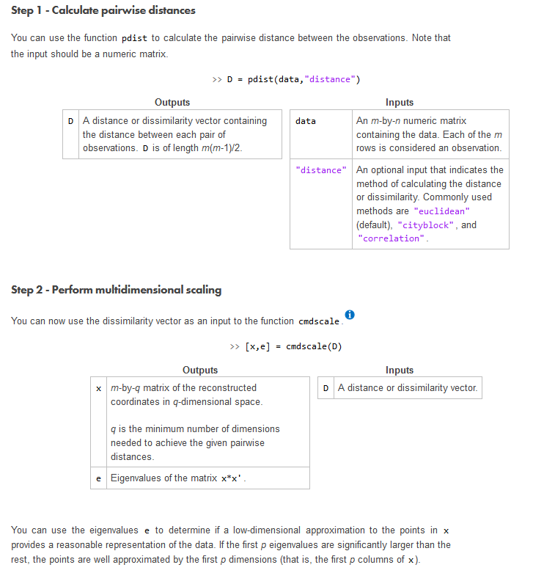
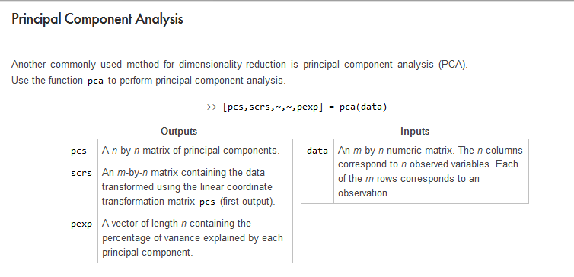
cmscale and pca

Slide 4
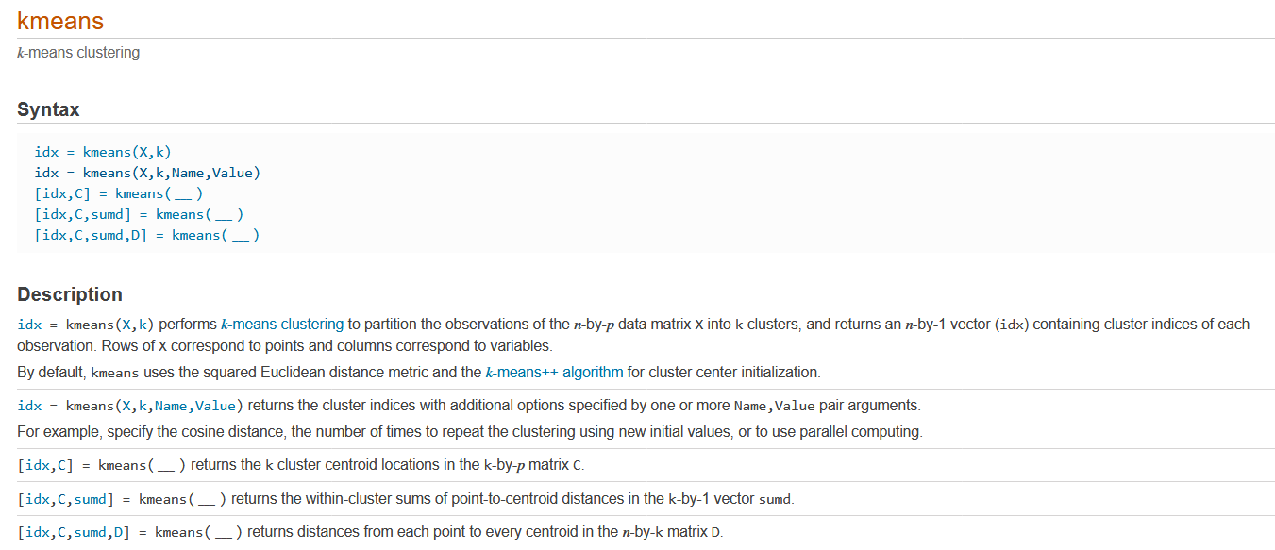
k-means clustering

